Slide 1
Fall Prevention Practices
Add name of center

Slide 2
Goals
Learn about:
Universal fall precautions in use
Assessment of fall risk factors
How risk factors are incorporated into care of the patient
How to assess and manage patients after a fall
How data on falls is collected and used

Slide 3
Fall Prevention Practices
Fall prevention practices include four separate activities:
Universal fall precautions
Standardized assessment of fall risk factors
Care and interventions that address risk factors
Post-fall procedures, including clinical review and huddles

Slide 4
Adapted to Fit This Center
The practices have been selected and are used based on the type of patients, procedures/surgeries and care flow in this center.

Slide 5
Universal Fall Precautions

Slide 6
Universal Fall Precautions
They apply to all patients.
The purpose is to keep all patients safe.
All staff who interact with patients will be trained on universal fall precautions.
Fall prevention is part of our center’s safety culture.

Slide 7
Universal Fall Precautions
Environment
Maintain clear pathways
Keep patient care areas uncluttered
Have sturdy handrails in patient bathrooms, hallways and rooms
Keep floors clean and dry
Clean up all spills promptly

Slide 8
Universal Fall Precautions
Equipment
Keep stretcher/bed brakes locked
Place the stretcher/bed in lowest position
Raise stretcher/bed to a comfortable height when the patient is transferring out of bed
Keep wheelchair wheel locks in “locked” position when stationary
Discharge patient from center in wheelchair

Slide 9
Universal Fall Precautions
Patient
Demonstrate call light/bell use and keep call light/bell within patient reach
Keep patient’s personal possessions within safe reach
Keep no-slip and well-fitting footwear on the patient
Staff assist patient to and from bathroom
Staff assists patient when dressing

Slide 10
Fall Risk Assessment

Slide 11
Fall Risk Assessment Tool
Morse Fall Scale
For adult patients
Helps identify patients at risk
Score provides basis for care interventions
Risk assessment is performed for all adult patients

Slide 12
Morse Fall Scale
History of falling (in last 3 months): Yes or No
Two or more secondary diagnoses in chart: Yes or No
Ambulatory aid:
None
Crutches/cane/walker
Furniture

Slide 13
Morse Fall Scale
IV or heparin lock: Yes or No
Gait:
Normal/wheelchair
Weak: Short steps (may shuffle), stooped but able to lift head while walking, may seek support from furniture while walking, but with light touch (for reassurance)
Impaired: Short steps with shuffle; may have difficulty arising from chair; head down; significantly impaired balance, requiring furniture, support person, or walking aid to walk

Slide 14
Morse Fall Scale
Mental status:
Oriented to own ability
Overestimates/forgets limitations

Slide 15
Morse Fall Scale
Record score for each of above items, then add to get a total score
Total score and associated risk level:
Score is less than 25: low risk
Score is 25 to 45: moderate risk
Score is more than 45: high risk

Slide 16
Care Plan Based on Risk

Slide 17
Care Plan
For all patients with a score of 25 or more, apply a yellow wrist band.
Your clinical judgment should be applied regardless of score
All our patients have heightened risk due to sedation / anesthesia / analgesia / surgery
Review areas of concern identified at risk assessment and
Select interventions to address each area of risk
Communicate interventions to all staff who care for the patient
Share the plan with the patient and family members

Slide 18
Sample Interventions
For history of falling:
Attend patient when changing and toileting
Assist all transfers
Wheelchair to vehicle
For secondary diagnoses tailor based on condition (e.g. impaired vision) and medications (e.g., medication that causes orthostasis)

Slide 19
Sample Interventions
For ambulatory aid:
Keep ambulatory aid at bedside
Advise patient to wait for staff assistance when mobilizing
Review dangers of using equipment (e.g., IV pole) as an ambulatory aid
For IV/heparin lock:
Advise patient to request help with toileting
Review side effects of medications with patient

Slide 20
Sample Interventions
For gait:
Advise patient to wait for staff assistance when moving from chair or bed
Review dangers of using equipment (e.g., IV pole) as an ambulatory aid
For mental status:
Use a bed alarm
Encourage family presence
Place patient in visible location

Slide 21
Post-Fall Assessment

Slide 22
What is a Fall?
A fall is defined as a sudden, uncontrolled, unintentional, downward displacement of the body to the ground or other object, excluding falls resulting from violent blows or other purposeful actions.

Slide 23
How are Fall Injuries Defined?
No injuries or None: The patient is free of injuries (no signs or symptoms) resulting from the fall
Minor: Bruise, abrasion; needs dressing, ice, limb elevation, topical medications, etc
Moderate: Needs sutures, Steri-Strips™/skin glue, splint, or resulted in muscle/joint strain
Major: Needs surgery, cast, traction; and/or results in neurological or internal injury
Death: The patient dies as a result of injuries sustained from the fall

Slide 24
Assess and Manage Patient
For all falls, even those that don’t appear to have resulted in injury, conduct a structured clinical assessment
Carefully assess patients for injuries in a systematic way
Manage injuries
Document your findings and interventions in the medical record
Report the incident

Slide 25
Conduct a Post-Fall Debriefing
Complete as soon as possible after fall occurs
Use Fall Debriefing Form to guide evaluation
Involve patient if possible
Discuss what happened as a group
Use discovery to determine why the patient fell

Slide 26
Post-Fall Debriefing Outcomes
Determine root cause
Determine preventability
Identify actions to prevent recurrence
Look for any trends (e.g., falls due to toileting)

Slide 27
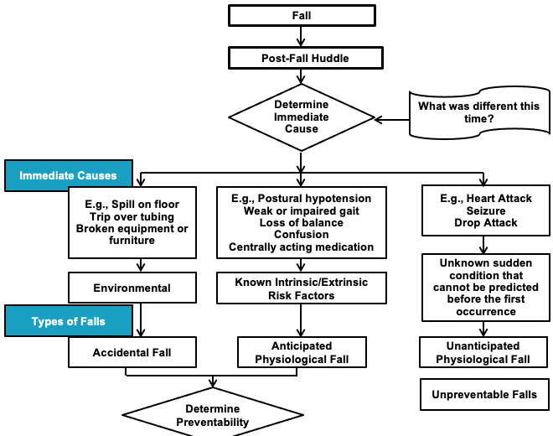
Decision Tree for Type of Fall
z

Slide 28
Use of Data Measuring Falls

Slide 29
Fall Measure Data
Derived from incident reporting system
Fall rates are calculated quarterly and shared with staff
Rates are benchmarked
Assess fall prevention care practices as needed
Develop an action plan as needed

